Slide 1


MD. SHAKIL
ID : 200121015
Batch : 15th
Semester : 10th
Program : B.Sc in CSE
European University of Bangladesh

Slide 2
Research Paper Title:
Face Mask Detection Using Convolutional Neural Network (CNN)

Slide 3

SUBMITTED
TO
SOVON CHAKRABORTY
Lecturer
Department of CSE
European University of Bangladesh (EUB).

Slide 4

PAPER DETAILES
Paper Title : Face Mask Detection using Convolutional Neural Network (CNN) reduce the spread of Covid-19.
Paper Type : Conference Paper
Publisher : IEEE
Published Date : April 2021
Authors
1) Sovon Chakroborty, 2) FM Javed Mehedi Shamrat, 3) Md. Masum Billah, | 4) Md. Al Jubair, 5) Md. Alauddin, 6) Rumesh Ranjan

Slide 5
WHY THEY HAVE CONDUCTED THIS RESEARCH?
The researchers in this paper developed a mask detection model using deep learning methods to prevent the spread of COVID-19. The model was trained on a dataset containing masked and unmasked images obtained from a variety of sources, including images of the coauthors captured using webcams and cell phone cameras. Goal of this research is to build a model which can accurately detect whether a person is wearing a mask, which can be used in real-world applications such as public places, workplaces or hospitals.

Slide 6
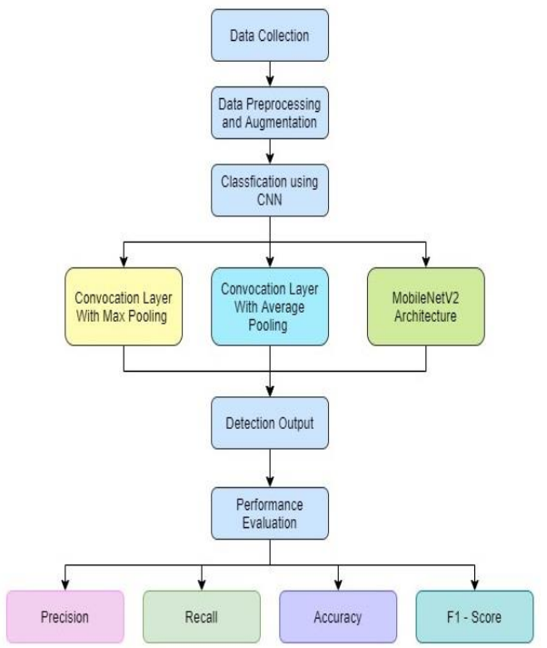
PROPOSED SYSTEM

Slide 7
PROPOSED SYSTEM (Cont.)
DATA COLLECTION
Firstly, in the data collection stage, they gather a large dataset with total 1845 images. The images can be obtained from various sources.

Slide 8
PROPOSED SYSTEM (Cont.)
DATA PREPROCESSING & AUGMENTATION
In the data preprocessing and augmentation stage, they clean and preprocess the data to be used for training the model. This may involve tasks such as resizing images, removing irrelevant information, and normalizing the data. They normalized images 256 x 256 pixels. Then resized images 128 x128 to pass the second layer of Convolutional2D and again 64 x 64 to pass the third Convolutional2D layer.

Slide 9
PROPOSED SYSTEM (Cont.)
TRAIN CLASSIFICATION MODEL
After preprocessing the data, they train a CNN model using different architectures such as Convolutional layer with Max Pooling, Convolutional layer with Average Pooling, and MobileNetV2. These architectures are designed to handle different types of images and tasks.

Slide 10
PROPOSED SYSTEM (Cont.)
DETECTION OUTPUT
After the classification stage, the CNN model outputs a binary decision for each image as to whether a mask is present or not.

Slide 11
PROPOSED SYSTEM (Cont.)
PERFORMANCE EVALUATION
Finally, evaluate the performance of the mask detection system using various metrics such as precision, recall, F1- score, and accuracy. The evaluation can be done on a separate validation dataset or through cross-validation on the original dataset.

Slide 12
ARCHITECTURE
CNN Architecture
Max Pooling
Average Pooling
MobileNetV2 Architecture

Slide 13
Convolution Layer With Max Pooling
In the proposed system, the input image is first passed through three convolutional layers with max pooling, followed by a flatten operation, a fully connected layer, and an output layer with softmax activation function.

Slide 14
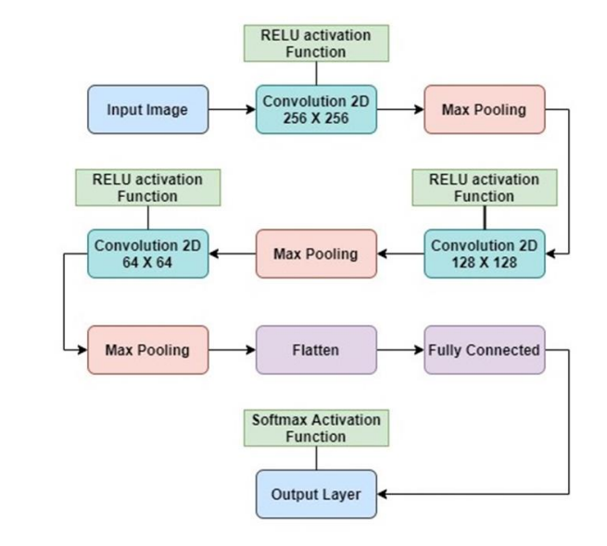
Convolution Layer With Max Pooling (Cont.)

Slide 15
Convolution Layer With Average Pooling
For function mapping again they used same architecture with the process of average pooling. In the proposed system, the input image is first passed through three convolutional layers with max pooling, followed by a flatten operation, a fully connected layer, and an output layer with softmax activation function.

Slide 16
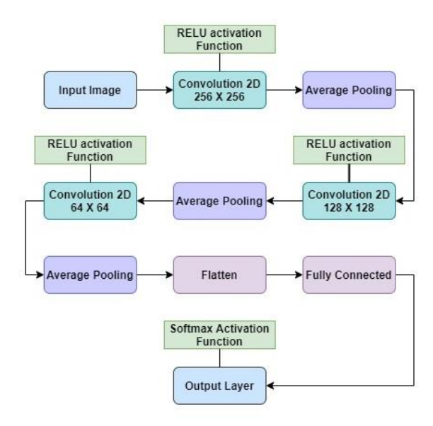
Convolution Layer With Average Pooling

Slide 17
MobileNetV2 Architecture
Also they used MobileNetV2 architecture for face musk detection. MobileNetV2 is a popular convolutional neural network architecture for image classification tasks. The architecture is based on depth wise separable convolutions, which allows for high accuracy with lower computational cost.

Slide 18
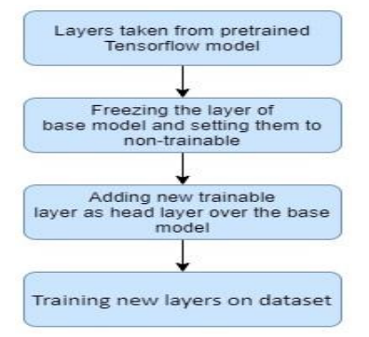
MobileNetV2 Architecture

Slide 19
EXPERIMENTED RESULT
Max Pooling
Average Pooling
MobileNetV2

Slide 20
EXPERIMENTED RESULT
For detecting face mask they used a dataset of 1845images. The proposed model achieved training accuracy 96.49% and validation accuracy 98.49% using Max pooling operation. The proposed model achieved training accuracy 95.19% and validation accuracy 96.23% using Average pooling operation. Using MobileNetV2 architecture achieved training accuracy 99.72% and validation accuracy 99.82% that is the highest accuracy.

Slide 21
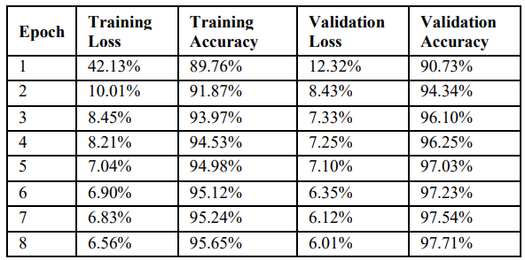
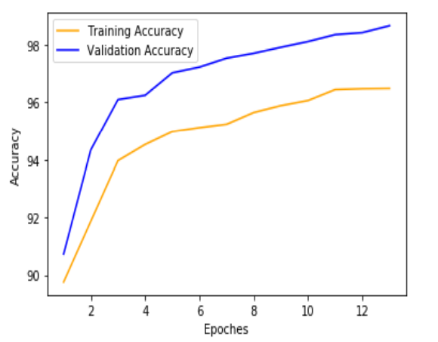
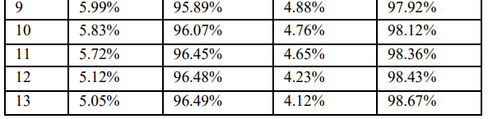
EXPERIMENTED RESULT (MAX POOLING)

Slide 22
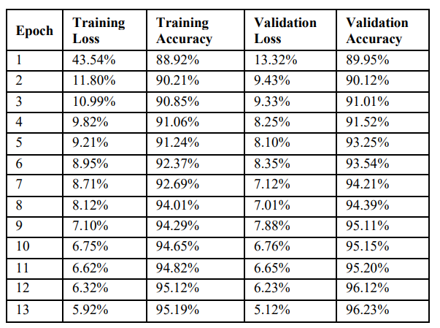
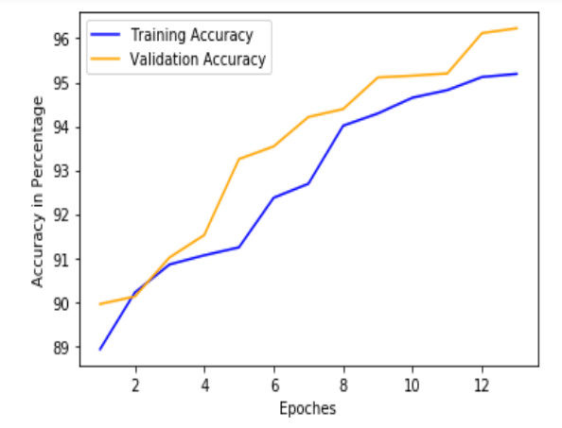
EXPERIMENTED RESULT (AVERAGE POOLING)

Slide 23
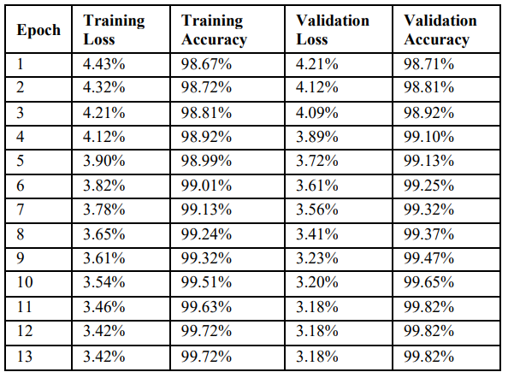
EXPERIMENTED RESULT (MobileNetV2)

Slide 24
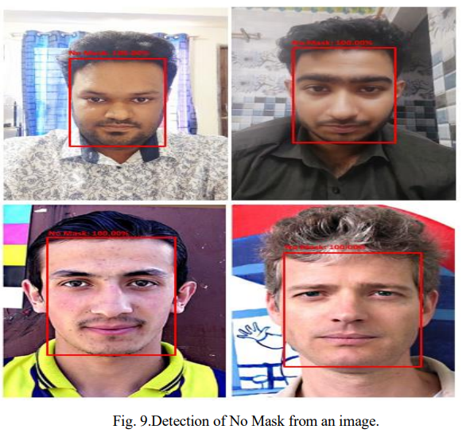
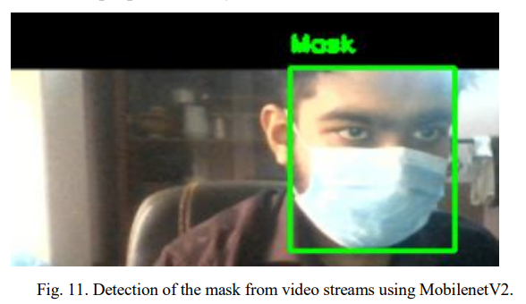
DETECTION OUTPUT

Slide 25




